Slide 1
Course : Computational Physics
Effective Period : April 2022
Introduction to Python Power Electronics Session 1

Slide 2
Objective and Outline
LO : Implement a computational simulation of basic electrical circuits using Python programming language
In this course we will be simulating power electronic circuits using Python. However, the Python part is not heavy. This course is ideal for students only with a basic knowledge of network theory and programming to get started with simulating simple power electronic circuits. The course contains a basic introduction to the Python Power Electronic (PPE) and describes how to use it to simulate simple rectifier (RLC) circuits.
In this session, we will start exploring a simulation concept using Open-Source Python Power Electronics
Download : https://www.pythonpowerelectronics.com/
Outline
Anaconda Installation
Setting up Anaconda environment for Python Power Electronics (PPE)
Introduction to Python Power Electronics UI and Web Server

Slide 3
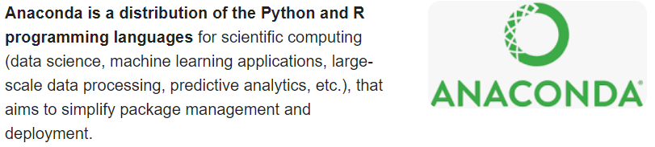
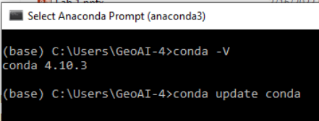
Anaconda Installation
Visit and follow the procedure written in these link https://docs.anaconda.com/anaconda/install/windows/ for windows or https://docs.anaconda.com/anaconda/install/mac-os/ for mac users
After the installation, you will find Anaconda Prompt (similar to command prompt or terminal) installed in your machine. Try opening this prompt and to check and update your conda version by typing :
conda –V
conda update conda
y

Slide 4
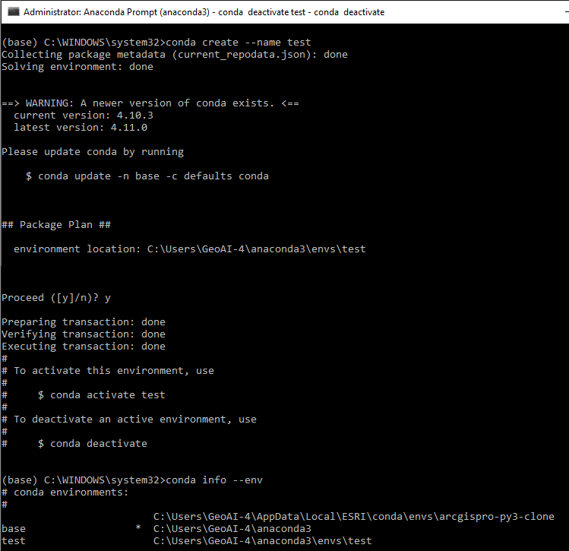
Conda Environment
https://conda.io/projects/conda/en/latest/user-guide/tasks/manage-environments.html
To create a new env named ‘test’
conda create --name test
To activate a named Conda env
conda activate test
To deactivate current env
conda deactivate
To list all env in your machine
conda info –env
conda env list
To list all packages and versions in a named environment
conda list --name test

Slide 5
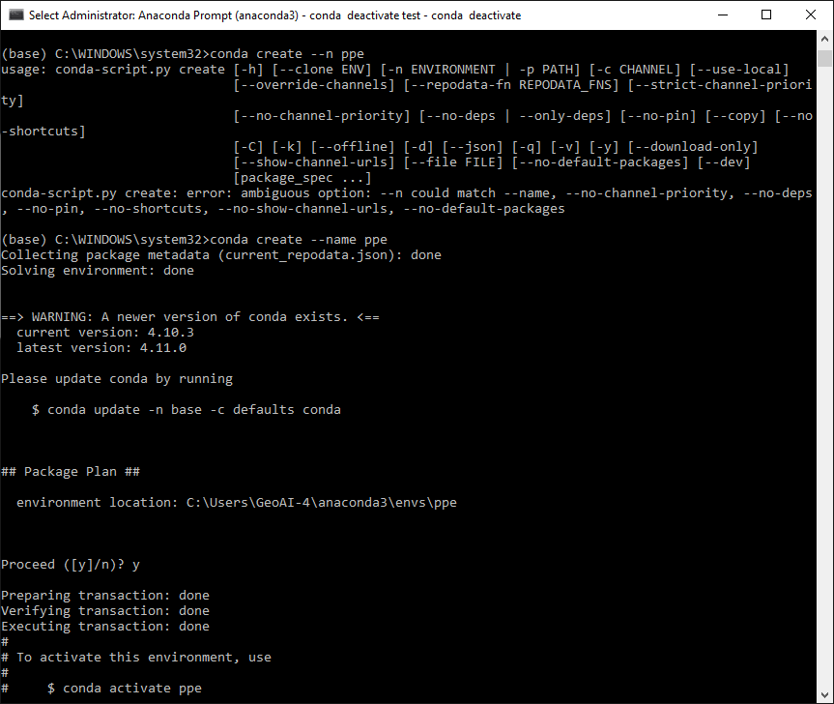
Conda Environment
Now, Create new environment named ‘ppe’
Activate/ deactivate the environment
Navigating around

Slide 6
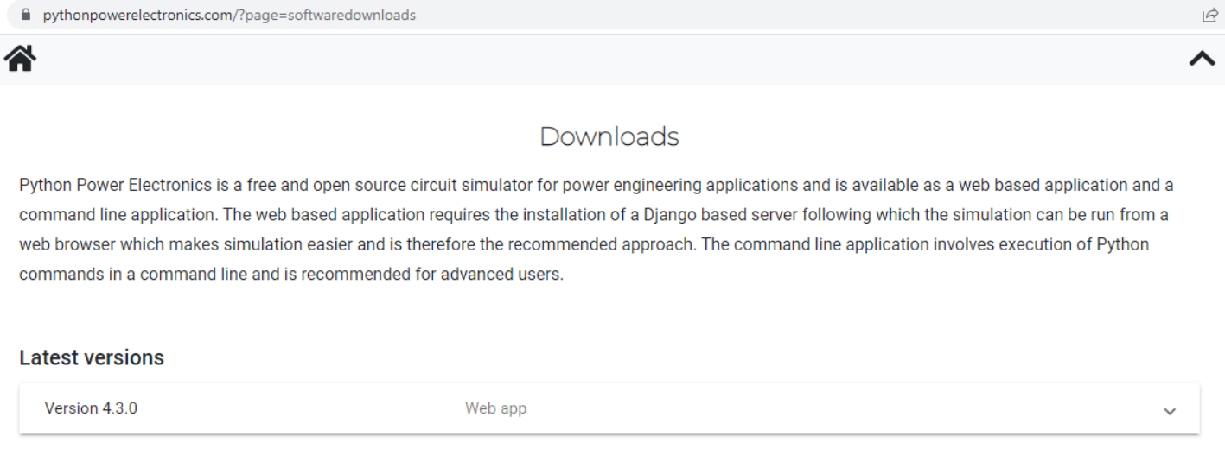
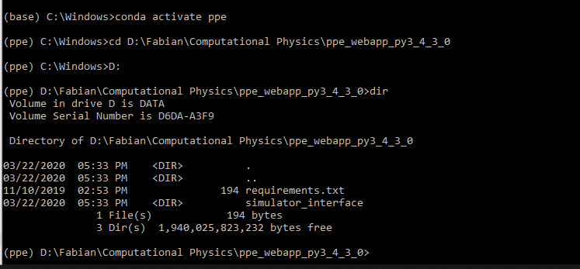
PPE Installation
Go and download PPE
https://www.pythonpowerelectronics.com/
Store the file in your preference directory where you will have all your simulation date. E.g: D:\......\Computational Physics
Activate the ‘ppe’ environment
Navigating using cd directory command to the file where you put the PPE files
Select drive first (e.g: D:), then
cd <space> directory url

Slide 7
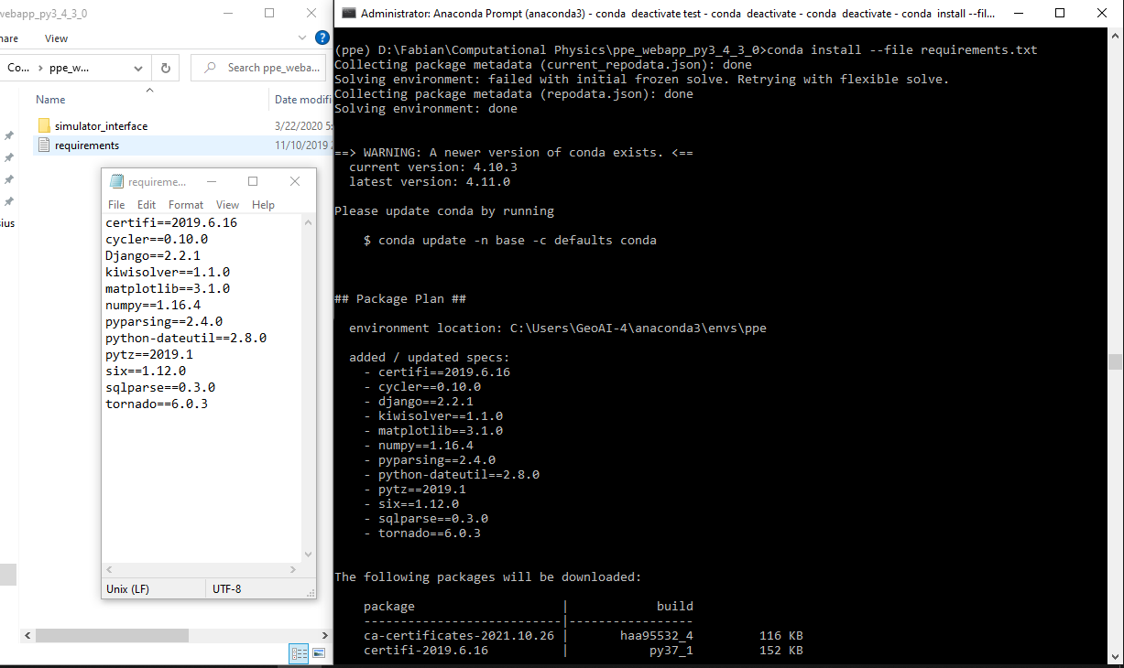
PPE Installation
Inside the installation files, you will find the requirement.txt
Install the requirement using
conda install –-file requirements.txt
Continue and accept all the installation.
This step is important because in python, there are dependencies between packages. Meaning, some packages in specific version can only work where other package with also specific version is available. Be informed about this!

Slide 8
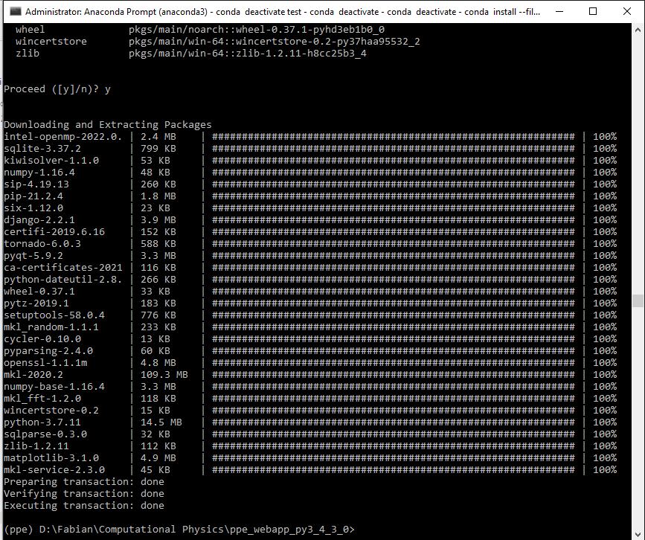
PPE Installation
Inside the installation files, you will find the requirement.txt
Install the requirement using
conda install –-file requirements.txt
Continue and accept all the installation.
This step is important because in python, there are dependencies between packages. Meaning, some packages in specific version can only work where other package with also specific version is available. Be informed about this!

Slide 9
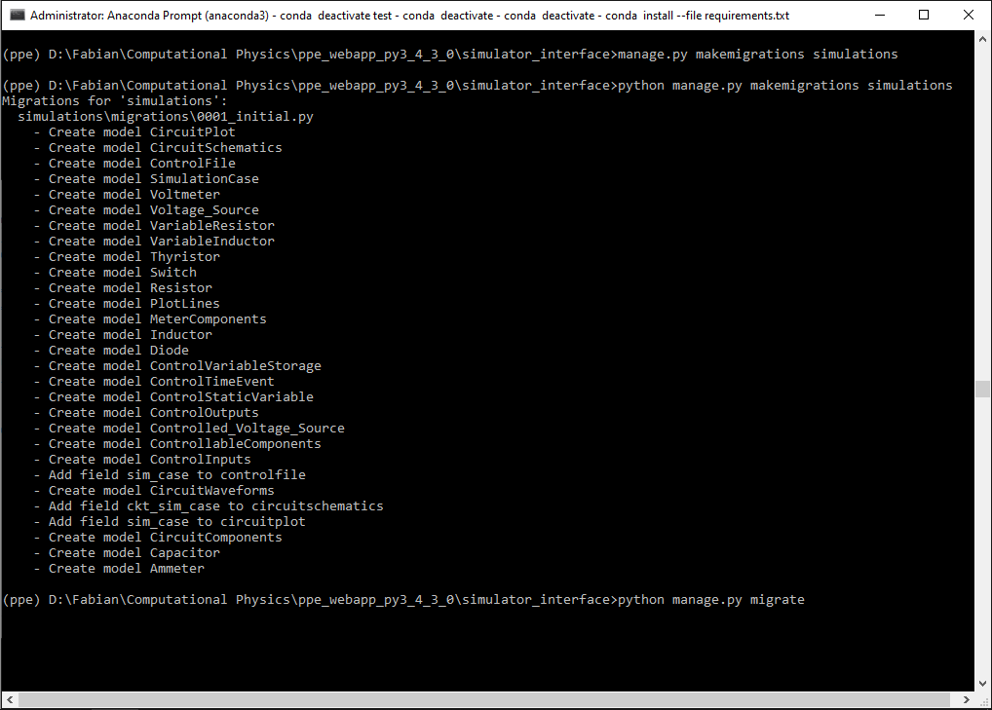
PPE Installation
Creating database structure for our simulation using
python manage.py makemigrations simulations
We then use the structure to create database by migration using
python manage.py migrate

Slide 10
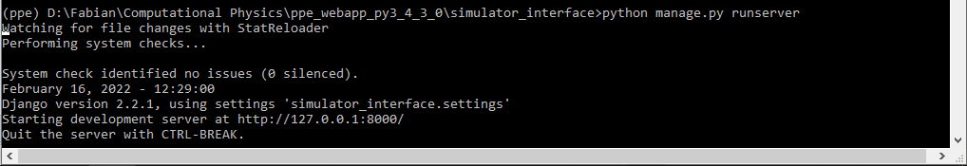
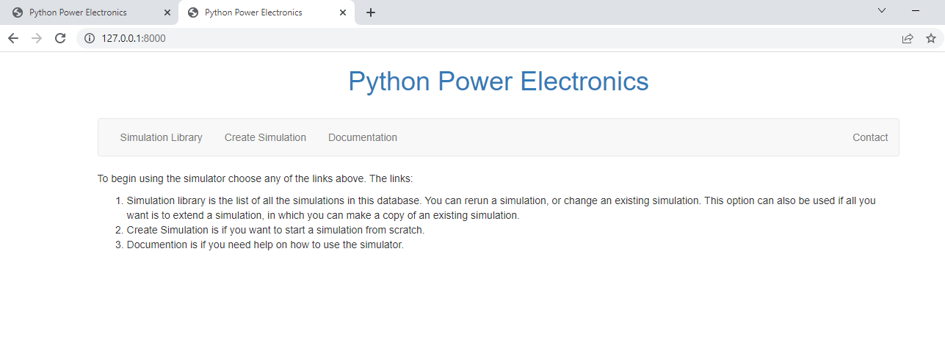
PPE Launch
Once everything is set up, we could run the webserver and access the UI through our browser. In the anaconda promt use
python manage.py runserver
Now open your internet browser, Chrome is preferred, then Copy http://127.0.0.1:8000/ (or other local IP address) and run it.
Explore and navigate through the web server for a while. Type CTRL + C at the Anaconda prompt to exit the web server
Congratulations! The PPE has installed in your machine

Slide 11
Session Summary
Now, you can try to run the webserver using these steps
Conda info –envs
Activate an environment
Go to manage.py folder directory (launch file)
If the structured database is already created, run the webserver by python manage.py runserver
Copy http://127.0.0.1:8000/ (or other IP Address) and run in your browser
If we still have time, we can discuss deeper about what are the Environment, Dependencies, Webserver, IP Address, or other terminologies used in this session. Its quite useful in the future. Or else you may look for it yourself.

